Slide 1
RUNGTA COLLEGE OF DENTAL SCIENCES & RESEARCH
Dental Restorative Materials in Pediatric Dentistry
DEPARTMENT OF PEDODONTICS AND PREVENTIVE DENTISTRY

Slide 2
Specific learning Objectives
Core areas | Domain
Introduction Cavity varnish Base cements | Amalgam Composites Crowns

Slide 3
CATEGORY
MUST TO KNOW
NICE TO KNOW
Zircomonomer
DESIRE TO KNOW
Recent advances
Silver amalgam
Composite
Bonded amalgam restoration

Slide 30
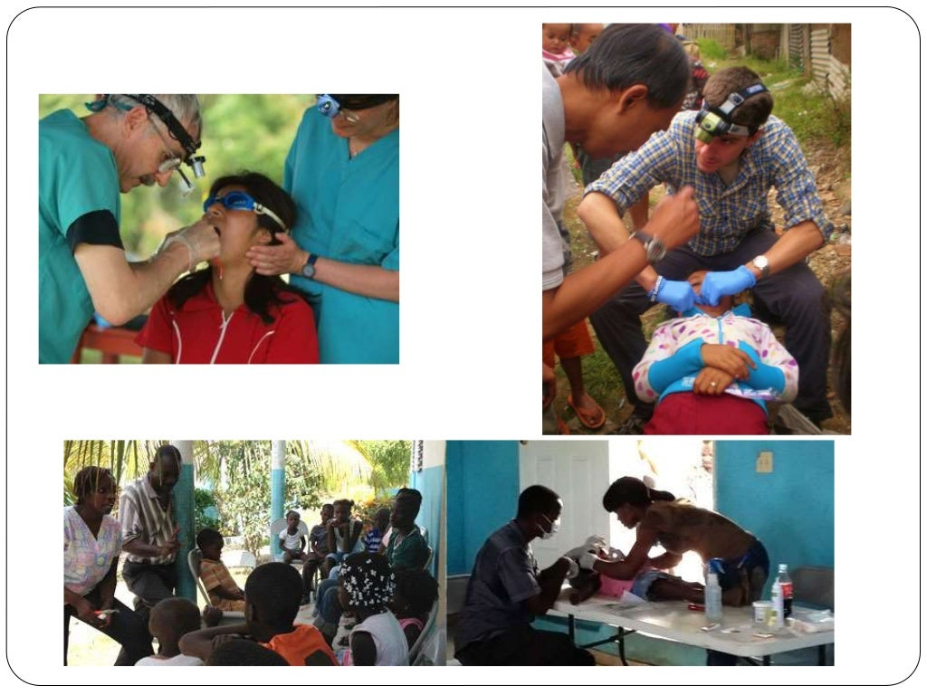

Slide 42
TAKE AWAY HOME MESSAGE
Dentist have used silver amalgam as a restorative material for more than 150years.
Composite is the universally used tooth coloured direct restorative material developed in 1962 by combining dimethacrylate with quads powder by Bowen.
Calcium hydroxide was introduced to dentistry by Herman in1936.

